Slide 1
Mean Reversion Monitoring and Trading on
Equity and Volatility Assets
05/26/2016
Notes:
KM: partager les meilleures pratiques quant + nouveau paradigm
TM: counter example – papier academique

Slide 2
Summary
I/ What is Mean Reversion ?
A simple definition
Our intuition on Mean Reversion
II/ Why consider Mean Reversion ?
For diversification purposes
The main drivers are known
Some detecting tools exist
Statistical illustration on some implied assets
III/ How to trade Mean Reversion ? A few examples
Example of trades on single underlying
Example of Pair trading strategy
Example of tactical trades on derivatives strategies

Slide 3
I- What is Mean Reversion ?

Slide 4
A simple definition
Mean Reversion is a key property of financial assets.
It characterizes the ability for an underlying asset to revert towards an average value after unusual moves away from that value:
-Extreme spikes are likely to be followed by drops
-Very sharp drops are likely to be followed by bullish runs

Slide 5
Our intuition on Mean Reversion
-10Y VIX historical average value has been around 21 for the past 10 years
-VIX well above 21 could be viewed as « expensive »
-VIX well below 21 could be viewed as « cheap »
- The observation window matters
US Equity Implied Volatility

Slide 6
Our intuition on Mean Reversion
JCJ Index is a CBOE measure of the implied correlation of the S&P 500 components through S&P 500 option prices
average has been around 61 for the past 2 years
- JCJ Index well above 61 could be viewed as « expensive »
- JCJ Index well below 61 could be viewed as « cheap »
US Equity Implied Correlation

Slide 7
Our intuition on Mean Reversion
VIX Index can be viewed as a proxy of 1M Variance swap price
Average carry has been positive around +3.3 points for the past 10 years
- A carry well above 3.3 could be viewed as « expensive »
- A carry well below 3.3 could be viewed as « cheap »
S&P 500 variance swap carry

Slide 8
Our intuition on Mean Reversion
Average variance swap realized spread between DAX Index and Eurostoxx 50 has been around -1 point for the past 10 years
- A spread well above -1 could be viewed as « expensive »
- A carry well below -1 could be viewed as « cheap »
Variance swap spreads

Slide 9
II- Why consider Mean Reversion ?

Slide 10
Diversification benefits
-North America
S&P 500 Index
NASDAQ 100 Index
RUSSEL 2000 Index
-Europe
EUROSTOXX 50
FTSE 100 Index
SMI index
-Asia
TOPIX Index
HANG SENG Index
HSCEI Index
Most Equity benchmarks are market cap weighted and thus follow a trend following behaviour

Slide 11
Diversification benefits
-Market cap weighted indices can turn to be overweight in some particular sector because of performance
-As a consequence exposure to financial bubbles can be significant
-Mean Reversion could help to mitigate negative effects of speculative bubble bursts
Potential diversification issues on Market cap weighted indices

Slide 12
The main drivers of mean reversion
Imbalance between offer and demand
liquidity:
Liquididy drought can often link to under or over Valuation levels
correlation is high between VIX major spikes and VIX futures liquidity
Short squeezes effects
Over / under supply consequences e.g. on commodities
Arbitrage
Hedge funds, proprietary traders and arbitragers
Attractiveness of asymnetric trades
Some drivers can be identified

Slide 13
The main drivers of mean reversion
-Implied correlation:
Impled correlation trades range bound between -1 and +1
-General Market participants behavior
Herd behaviour of market participans can link to overvaluation e.g. bubles
Implied volatility, skew, term structure and vol of vol are regarded as mean reverting
Common belief often becomes self fulfilling
Some assets are « believed » to be mean reverting

Slide 14
Some detecting tools
Simple Ideas:
Find the maximum amount of mean reversion while constraining the variance to be larger than a certain threshold →
Multi Resolution Volatility : MRV,
Asses how the process behaves when its volatility is studied at different time scales
Projection Pursuit Algorithm : PPA
A Neural type of algorithm which pursues a target : residual generates a mean reverting asset
Vol increases

Slide 15
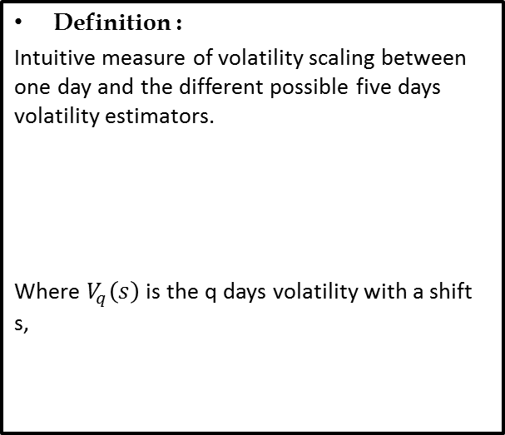
Some detecting tools
Definition :
Intuitive measure of volatility scaling between one day and the different possible five days volatility estimators.
Where $V_{q}\left(s\right)$is the q days volatility with a shift s,
If MRV < 1, it implies a negative auto-correlation → mean reversion
If MRV > 1, it implies a positive auto-correlation → trend following
MRV : Multi Resolution Volatility
Notes:
KM: Titre attention au charlatanisme et attention au baktest brute force
TM: quid si on pousse un peu plus la simulation

Slide 16
Some detecting tools
Experiment :
Take a universe of Equity assets, compute the 100 days cross section MRV indicator
SX5E universe Spots
Do the same for volatility asset.
SX5E universe Vols
MRV: detection for single underlyings
Notes:
KM: Titre attention au charlatanisme et attention au baktest brute force
TM: quid si on pousse un peu plus la simulation

Slide 17
Some detecting tools
Experiment :
MRV indicator on the near by future volatility Index FVS1
Indicator does a good segmenting job on the volatility signal with a minimum lag.
MRV: detection for volatility assets
Notes:
KM: Titre attention au charlatanisme et attention au baktest brute force
TM: quid si on pousse un peu plus la simulation

Slide 18
Some detecting tools
Definition :
On a universe of assets explore all couples and compute the MRV indicator of every couple.
It is a change of numéraire: buying Z means you buy X and you pay with numéraire Y.
MRV: detection of spreads
Notes:
KM: Titre attention au charlatanisme et attention au baktest brute force
TM: quid si on pousse un peu plus la simulation

Slide 19

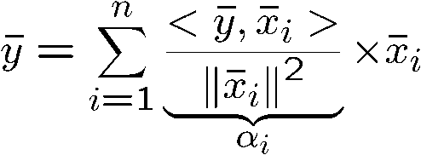
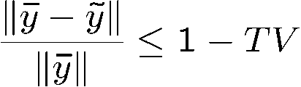




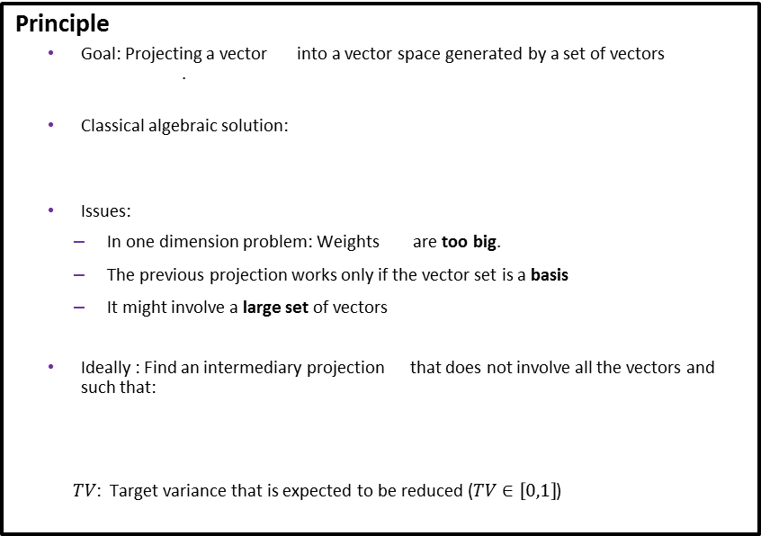

Some detecting tools
Principle
Goal: Projecting a vector into a vector space generated by a set of vectors .
Classical algebraic solution:
Issues:
In one dimension problem: Weights are too big.
The previous projection works only if the vector set is a basis
It might involve a large set of vectors
Ideally : Find an intermediary projection that does not involve all the vectors and such that:
$TV$: Target variance that is expected to be reduced ($TV∈\left[0,1\right]$)
$$x_{1}$$
$$α_{i}$$
$$α_{1}$$
$$α_{2}$$
$$x_{2}$$
PPA
Notes:
KM: Titre attention au charlatanisme et attention au baktest brute force
TM: quid si on pousse un peu plus la simulation

Slide 20
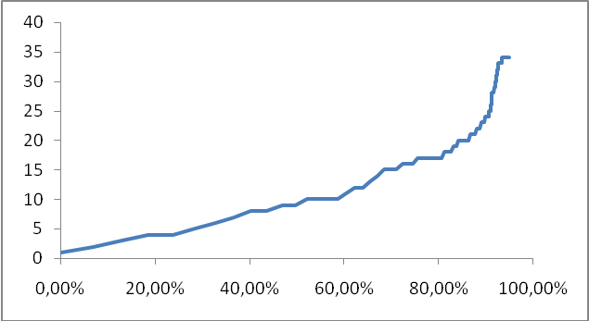
Some detecting tools
Principle
Goal: construction of a portfolio composed of few assets designed to replicate a basket or an index using a subset of the original basket
→Control bias : 0 bias is equivalent to high mean reversion
→Control tracking error : not too low
From a full basket
To an incomplete one
Example :
partial replication of the CAC40
Number of assets to explain % of the variance,
90% of the assets explained by half of the assets
PPA: incomplete basket – benchmark tracking
Notes:
KM: Titre attention au charlatanisme et attention au baktest brute force
TM: quid si on pousse un peu plus la simulation

Slide 21
Some detecting tools
Principle
Track a sector with weight constraints on stocks, sectors or countries➔ diversification.
Example:
Target S&P500
Universe: 500 stocks of the S&P500
Revision: every 60 days
Historical: 300 days
Min weight on stocks: 1% / sectors : 1%
Max weight on stocks: 10% / sectors : 10%
Target explained variance: 98%
PPA: Sectorial Asset Management
Notes:
KM: Titre attention au charlatanisme et attention au baktest brute force
TM: quid si on pousse un peu plus la simulation

Slide 22
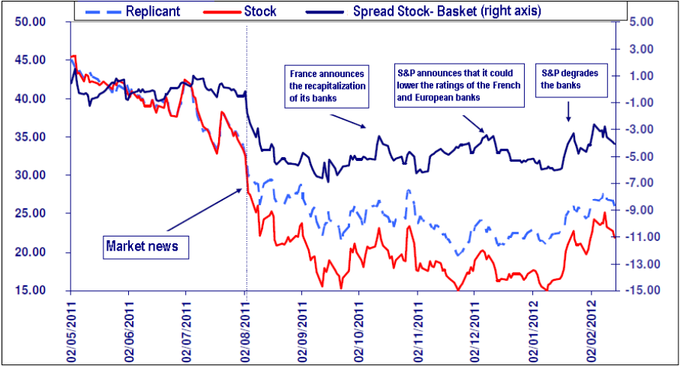
Some detecting tools
Principle
Some news goes out to the markets and impacts a certain asset and its sector
[PPA] builds the friendly basket that tracks the asset and singles out the value of the news
Example : a Bank XYZ in August 2011
Problem : if the news of a particular newspaper are groundless, at what price would the bank XYZ get back?
Replication of the stock XYZ with a basket of banking stocks
PPA: Value News
Notes:
KM: Titre attention au charlatanisme et attention au baktest brute force
TM: quid si on pousse un peu plus la simulation

Slide 23
Some detecting tools
Tool | reversion | Asset example
MRV mono asset | Self mean reverting | Equity asset and volatility asset
MRV pairs | 1 to 1 mean reverting | Pairs of an index/sector/region
PPA | 1 to N assets | Equity and volatility basket
Detection tools
Notes:
KM: Titre attention au charlatanisme et attention au baktest brute force
TM: quid si on pousse un peu plus la simulation

Slide 24
Statistical illustration on some implied assets
Since January 1990:
-The VIX Index closed around 7% of the time above the highest closing value achieved during the previous 22 business days
-Once above its highest previous value, the VIX index stayed in average a period of 1.68 days above that value before moving back down
- The VIX Index has never moved up by more than 25 points during such a periods consecutive days
illustration of Upside Mean Reversion on the VIX Index

Slide 25
Statistical illustration on some implied assets
Since June 2007:
-The cboe VVIX Index represents a measure of the expected volatility of the 30-day forward price of the VIX index
The VVIX Index closed around 7% of the time above the highest closing value achieved during the previous 22 business days
-Once above its highest previous value, the VVIX index stayed in average a period of 1.59 days above that value before moving backdown
- The VVIX Index has never moved up by more than 60 points during such periods of consecutive days
Illustration of Upside Mean Reversion on the VVIX Index

Slide 26
Statistical illustration on some implied assets
Since June 2007:
-The CBOE VVIX Index represents a measure of the expected volatility of the 30-day forward price of the VIX index
-The VVIX Index closed around 10% of the time below the lowest closing value achieved during the previous 22 business days
-Once above its lowest previous value, the VVIX index stayed in average a period of 1.82 days below that value before moving back up
- The VVIX Index has never moved down by more than 18 points during such periods of consecutive days
Illustration of Downside Mean Reversion on the VVIX Index

Slide 27
Statistical illustration on some implied assets
Since March 2007:
-The 1Y S&P 500 implied correlation Index (CBOE JCJ) closed around 6% of the time above the highest closing value achieved during the previous 22 business days
-Once above its highest previous value, the JCJ index stayed in average a period of 1.35 days above that value before moving back down
- The JCJ Index has never moved up by more than 14 points during such periods of consecutive days
Illustration of Upside Mean Reversion on the S&P 500 implied Correlation

Slide 28
Statistical illustration on some implied assets
Since March 2007:
-The 1Y S&P 500 implied correlation Index (CBOE JCJ) closed around 11% of the time below the lowest closing value achieved during the previous 22 business days
-Once below its lowest previous value, the JCJ index stayed in average a period of 1.81 days below that value before moving back up
-However the highest period lenght was 5 consecutive days
- The JCJ Index has never moved down by more than 9 points during such periods of consecutive days
Illustration of Downside Mean Reversion on the S&P 500 implied Correlation

Slide 29
Statistical illustration on some implied assets
Since 1990:
-The spread (VIX – S&P 500 realized volatility) closed around 11% of the time above the highest closing value achieved during the previous 22 business days
-Once above its highest previous value, the spread stayed in average a period of 1.81 days above that value before moving down
-However the highest period lenght was 7 consecutive days
- The spread has never moved up by more than around 30 points during such periods of consecutive days
Illustration of Upside Mean Reversion on the S&P 500 variance swap

Slide 30
III-
How to trade Mean Reversion ?
A few examples

Slide 31
Example of trades on single underlyings
From Theoretical Case to reality:
After a Mean Reverting candidate has been identified a trading strategy is taking place
Check List:
-trading frequency
-Type of instruments
-Use of systematic strategies (using the stock)
-Use of Option Inspired systematic strategies
-Use of derivative contracts
Discretionnary versus Systematic

Slide 32
Example of trades on single underlyings
Theoritical investment strategy:
-Identification of a single asset mean reverting :
MRV < 1
-Buy weekly volatility swap against daily volatlity swaps
-In theory product is worth 0 but it pays in average realised volatility x (1-MRV)
Execution: through use of derivative contracts or replicants
Notes:
KM: Titre attention au charlatanisme et attention au baktest brute force
TM: quid si on pousse un peu plus la simulation

Slide 33
Example of trades on single underlyings
Theoritical investment strategy:
Long only strategy
completely hedged on days where the average MRV indicator increases faster (one parameter strategy)
-Intuition behind : rapid upward move of the MRV average is a sign of imbalance → Sign of future negative return
-Limited risk for overfitting
MRV: Simple and efficient
Notes:
KM: Titre attention au charlatanisme et attention au baktest brute force
TM: quid si on pousse un peu plus la simulation

Slide 34
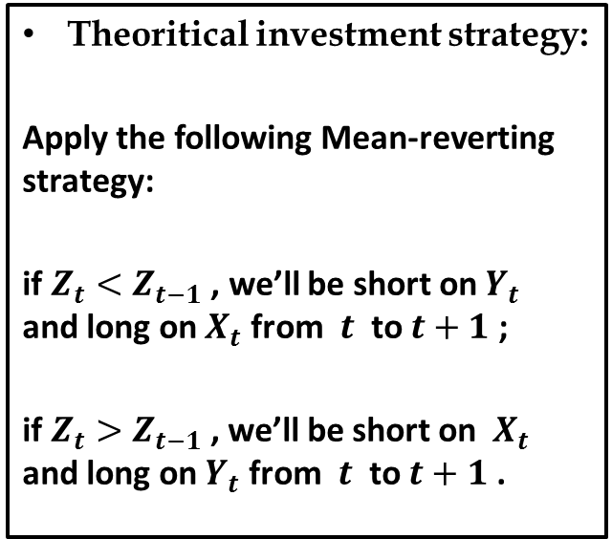
Example of pair trading
Theoritical investment strategy:
Apply the following Mean-reverting strategy:
if $Z_{t}<Z_{t−1}$ , we’ll be short on $Y_{t}$ and long on $X_{t}$ from $t$ to $t+1$ ;
if $Z_{t}>Z_{t−1}$, we’ll be short on $X_{t}$ and long on $Y_{t}$ from $t$ to $t+1$ .
MRV : Pair Trading
Notes:
KM: Titre attention au charlatanisme et attention au baktest brute force
TM: quid si on pousse un peu plus la simulation

Slide 35
Example of pair trading
Theoritical investment strategy:
Apply to few pairs and extend to a basket
Portfolio construction by selecting the most mean-reversion or trend following pairs from the components of SX5E
MRV : Potfolio of Pairs
Notes:
KM: Titre attention au charlatanisme et attention au baktest brute force
TM: quid si on pousse un peu plus la simulation

Slide 36
Example of tactical trades on derivatives strategies
S&P 500 Variance swap trades
-Sell a short term Variance swap on the S&P 500 Index
-Start monitoring the trade when the spread (VIX Index – 1M realized vol of S&P500) has been above its highest value (on a 22 business day window) for a few consecutive days
Rationale: The spread has never closed above its highest value (on a 22 business day window) for more than 7 consecutive days
VIX vanilla options trades
-Buy a short term call on the VIX Index
- Start monitoring the trade when the VVIX has been below its lowest value (on a 22 business day window) for a few consecutive days
Rationale: The VVIX has never closed below its lowest value (on a 22 business day window) for more than 6 consecutive days
Dispersion trades
-Buy short term dispersion
Start monitoring the trade when the S&P500 implied correlation has been above its highest achieved value (on a 22 business day window) for a few consecutive days
Rationale: The S&P500 implied correlation has never closed above its highest value (on a 22 business day window) for more than 2 consecutive days
Some (historically) assymnetric trade ideas

Slide 37
Conclusion

Slide 38
Disclaimer
This document is for discussion and information purposes only. It is highly confidential and it is the property of Natixis. It should not be transmitted to any person other than the original addressee(s) without the prior written consent of Natixis.
This document is a marketing presentation. It does not constitute an independent investment research and has not been prepared in accordance with the legal requirements designed to promote the independence of investment research. Accordingly there are no prohibitions on dealing ahead of its dissemination.
The distribution, possession or delivery of this document in, to or from certain jurisdictions may be restricted or prohibited by law. Recipients of this document are therefore required to ensure that they are aware of, and comply with, such restrictions or prohibitions. Neither Natixis, nor any of its affiliates, directors, employees, agents or advisers nor any other person accept any liability to anyone in relation to the distribution, possession or delivery of this document in, to or from any jurisdiction.
This document is communicated to each recipient for information purposes only and does not constitute a personalised recommendation. It is intended for general distribution and the products or services described herein do not take into account any specific investment objective, financial situation or particular need of any recipient. It should not be construed as an offer or solicitation with respect to the purchase, sale or subscription of any interest or security or as an undertaking by Natixis to complete a transaction subject to the terms and conditions described in this document or any other terms and conditions. Any guarantee, funding, interest or currency swap, underwriting or more generally any undertaking provided for in this document should be treated as preliminary only and is subject to a formal approval and written confirmation in accordance with Natixis’ current internal procedures.
Natixis has neither verified nor independently analysed the information contained in this document. Accordingly, no representation, warranty or undertaking, express or implied, is made to recipients as to or in relation to the accuracy or completeness or otherwise of this document or as to the reasonableness of any assumption contained in this document. The information contained in this document does not take into account specific tax rules or accounting methods applicable to counterparties, clients or potential clients of Natixis. Therefore, Natixis shall not be liable for differences, if any, between its own valuations and those valuations provided by third parties; as such differences may arise as a result of the application and implementation of alternative accounting methods, tax rules or valuation models.
Prices and margins are deemed to be indicative only and are subject to changes at any time depending on, inter alia, market conditions. Past performance and simulations of past performance are not a reliable indicator and therefore do not predict future results. The information contained in this document may include results of analyses from a quantitative model, which represent potential future events that may or may not be realised, and is not a complete analysis of every material fact representing any product. Information may be changed or withdrawn by Natixis at any time without notice. More generally, no responsibility is accepted by Natixis, nor by any of its holding companies, subsidiaries, associated undertakings or controlling persons, or any of their respective directors, officers, partners, employees, agents, representatives or advisors as to or in relation to the characteristics of this information.
The statements, assumptions and opinions contained in this document may be forward-looking and are therefore subject to risks and uncertainties. Actual results and developments may differ materially from those expressed or implied, depending on a variety of factors and accordingly there can be no guarantee of the projected results, projections or developments.
Natixis makes no representation or warranty, expressed or implied, as to the accomplishment of or reasonableness of, nor should any reliance be placed on any projections, targets, estimates or forecasts, or on the statements, assumptions and opinions expressed in this document. Nothing in this document should be relied on as a promise or guarantee as to the future.
It should not be assumed that the information contained in this document will have been updated subsequent to the date stated on the front page of this document. In addition, the delivery of this document does not imply in any way an obligation on anyone to update the information contained herein at any time.
Natixis shall not be liable for any financial loss or any decision taken on the basis of the information contained in this document and Natixis does not hold itself out as providing any advice, particularly in relation to investment services. In any event, you should request any internal and/or external advice that you consider necessary or desirable to obtain, including any financial, legal, tax or accounting advice, or any other specialist advice, in order to verify in particular that the investment(s) described in this document meets your investment objectives and constraints, and to obtain an independent valuation of such investment(s), and the risk factors and rewards.
Natixis is authorised in France by the Autorité de contrôle prudentiel (ACP) as a Bank – Investment Services Provider and subject to its supervision. Natixis is regulated by the AMF in respect of its investment services activities.
Natixis is authorised by the ACP in France and subject to limited regulation by the Financial Services Authority in the United Kingdom. Details on the extent of our regulation by the Financial Services Authority are available from us on request.
Natixis is authorised by the ACP and regulated by the BaFin (Bundesanstalt für Finanzdienstleistungsaufsicht) for the conduct of its business in Germany.
Natixis is authorised by the ACP and regulated by Bank of Spain and the CNMV for the conduct of its business in Spain.
Natixis is authorised by the ACP and regulated by Bank of Italy and the CONSOB (Commissione Nazionale per le Società e la Borsa) for the conduct of its business in Italy.
This document is not intended for distribution in the United States, or to any US person, or in Canada, Australia, the Republic of Ireland, the Republic of South Africa or Japan.
38

